Slide 1
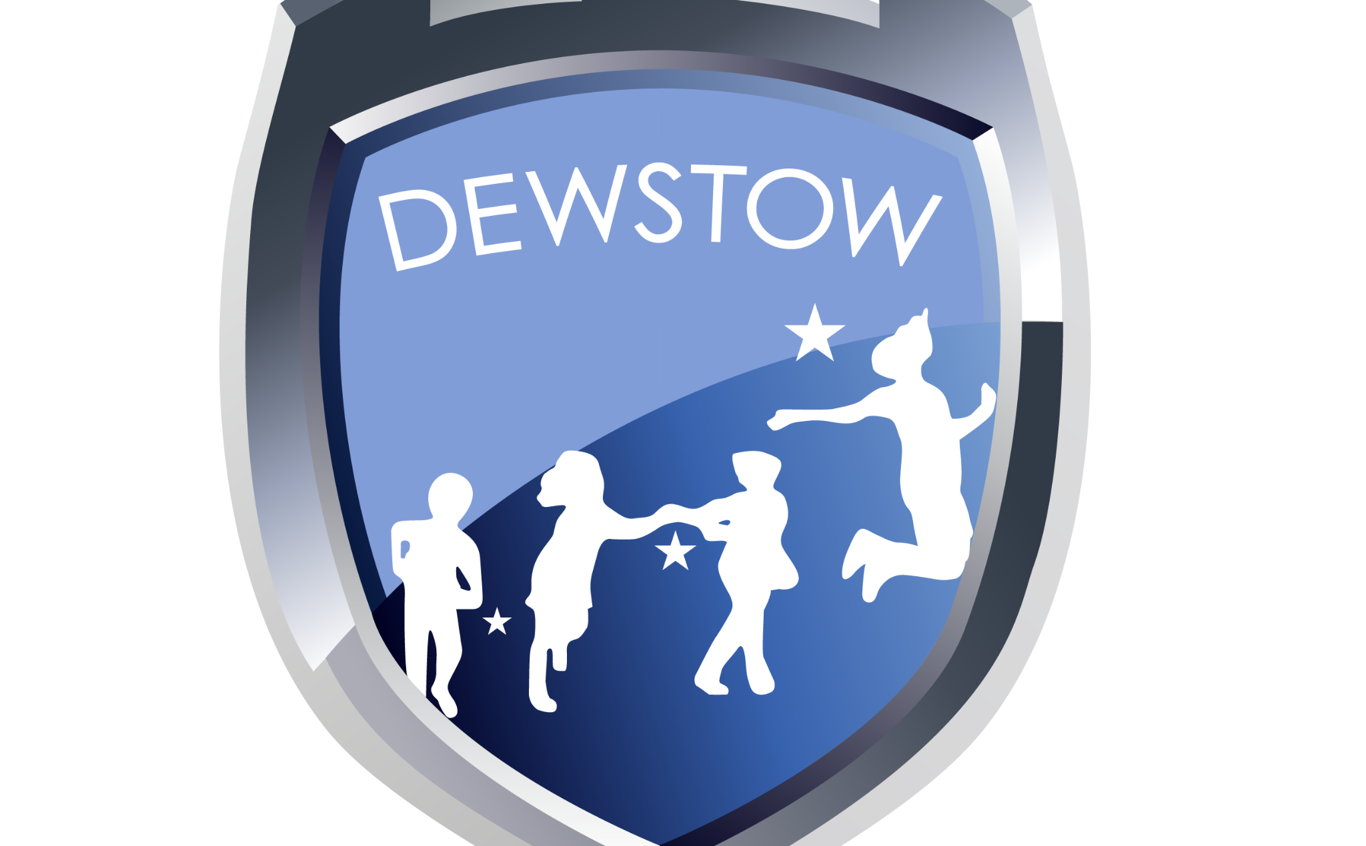
Languages, literacy and communication
In literacy, we will begin the term by exploring identity, diversity, and empathy through the book The Proudest Blue, using its powerful narrative to inspire our own creative retell. . As the term progresses, the focus will shift toward informative and non-fiction writing connected directly to our historical topic. We will apply our research on Roman life and local heritage to design, write, and produce detailed visitor leaflets for the Caerleon Museum, developing key skills in, persuasive language, and factual reporting.
What did the Romans do for us?
This term, we will explore the Roman Empire's lasting legacy by asking, "What did the Romans ever do for us?" We will investigate how past invasions and culture shaped modern society, infrastructure, and daily life. A key focus connects this history directly to Welsh heritage through Roman Caerleon, where we will examine local landmarks and artefacts to understand how Roman governance and beliefs influence our community today.
Science and Technology
We will explore how scientific inquiry and engineering shape our understanding of the world. Using design thinking, we will tackle practical, real-world problems. We will also investigate matter and materials by testing physical properties to discover how substances behave. Alongside hands-on experimentation, we will build foundational skills in computational thinking to understand how digital systems process information.
Health and Wellbeing
In health and wellbeing, we will investigate how social interactions, community connections, and cultural heritage shape personal identity and overall wellness. In physical education, we will stay active through dynamic practical sessions, developing core agility, strength, and coordination by alternating weekly between gymnastics and rugby skills delivered in partnership with Dragons Rugby.
Year 3
Autumn term 2026
Mathematics and Numeracy
In mathematics and numeracy, we will deepen our understanding of foundational concepts though practical application and problem-solving. We will explore place value to build a strong grasp of number structure and relative size. We will develop both mental and written calculation strategies for addition and subtraction, before advancing our operational skills with multiplication and division to solve multi-step mathematical challenges.
Expressive Arts
We will be immersing ourselves in hands-on artistic performance and visual design throughout the term. In music, we will develop our performance skills by learning to play the penny whistle, building foundational pitch and rhythm technique. We will also experiment with drawing and hatching techniques, build dramatic narrative through roleplay workshops, and collaborate directly with Welsh artist Rhiannon Roberts on a bespoke artistic project.
Humanities
We will investigate Roman life to discover how past invasions, governance, and culture continue to shape our world today. We will explore Roman daily life, beliefs, and social structures, while linking this global history directly to local Welsh heritage. Using the rich Roman history of Caerleon, we will examine how local landmarks and historical events have influenced our community's identity over time.
Together we learn, together we grow

