Slide 1

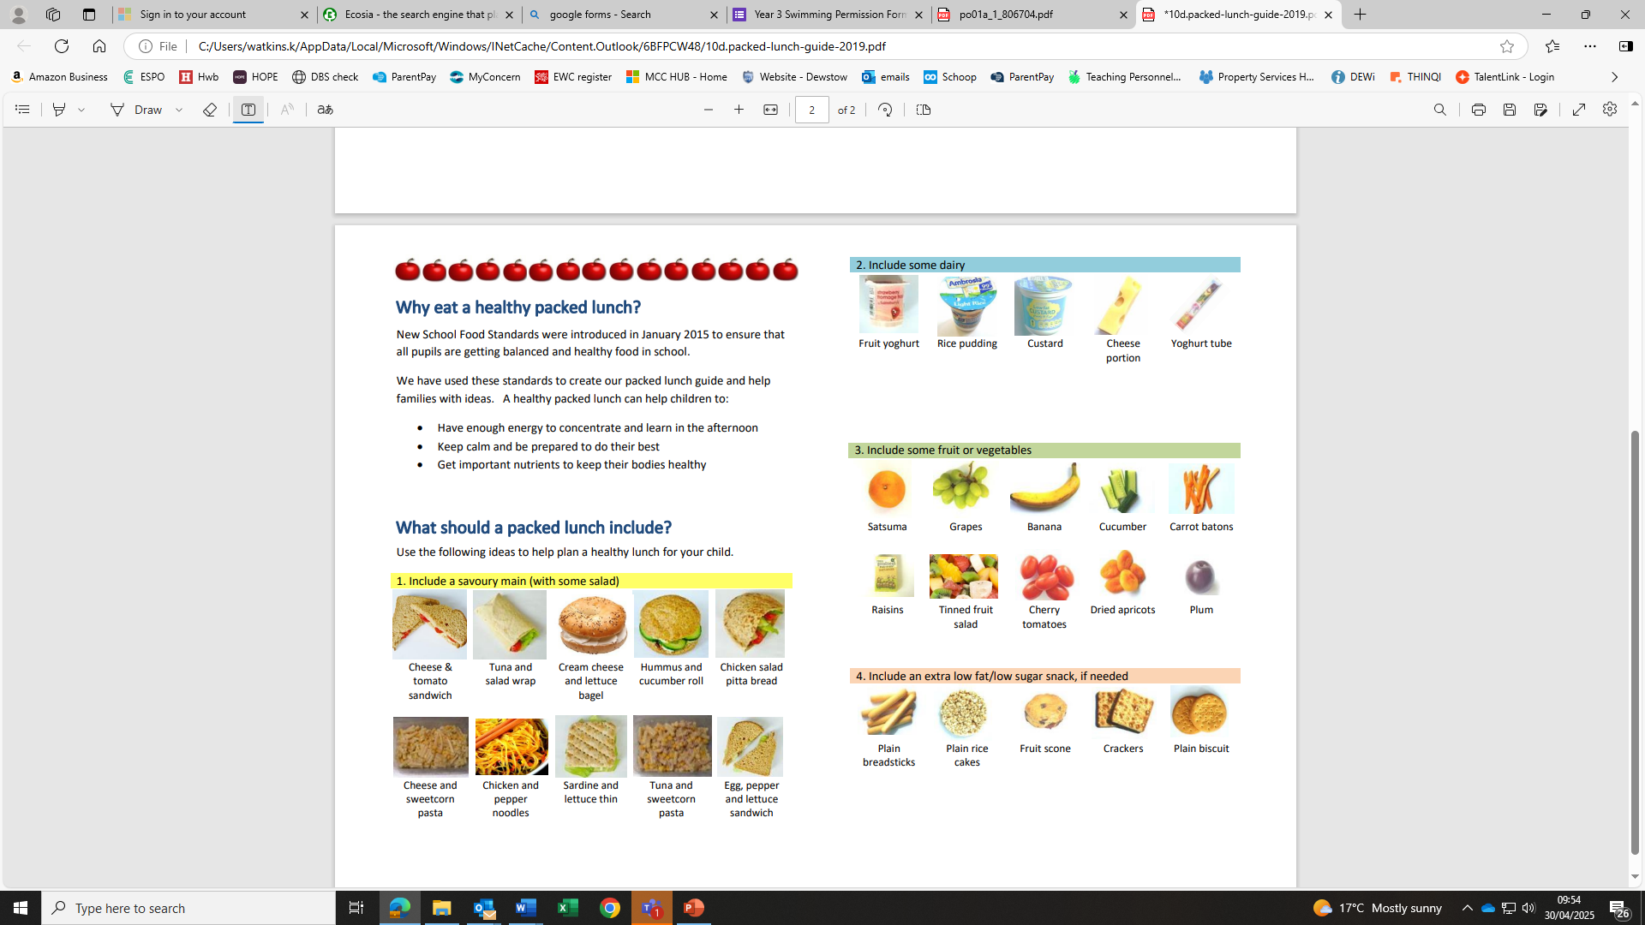
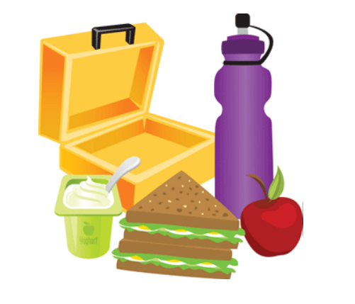

What should a packed lunch not include?
To keep pupils lunches as healthy as possible, we would like the following items not to be included in packed lunches:
Crisps or flavoured crisp type products e.g. snack-a-jacks
Sweets
Chocolate or chocolate items such as biscuits, yoghurts, cakes or desserts
What should a packed lunch include?
Use the following ideas to help plan a healthy lunch for your child.
Dewstow Primary School
‘Together we learn, together we grow’
What drinks should be included?
Dewstow Primary & Nursery School is a water only school, with the exception of free school milk for Nursery to Year 2 pupils.
All pupils should bring a drinks bottle to school each day.
Fresh water is available from our chilled water dispensing unit throughout the day.
Why eat a healthy packed lunch?
New School Food Standards were introduced in January 2015 to ensure that all pupils are getting balanced and healthy food in school.
We have used these standards to create our packed lunch guide and help families with ideas. A healthy packed lunch can help children to:
Have enough energy to concentrate and learn in the afternoon
Keep calm and be prepared to do their best
Get important nutrients to keep their bodies healthy
Packed Lunch Guide

