Slide 1


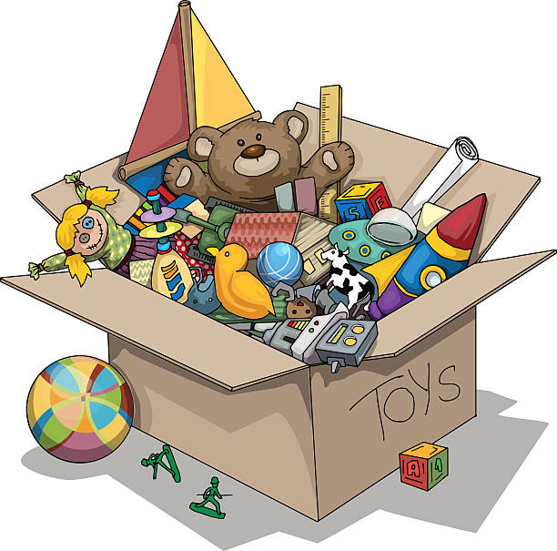

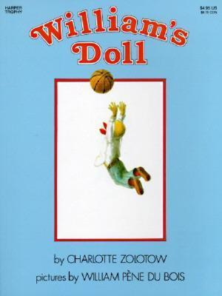

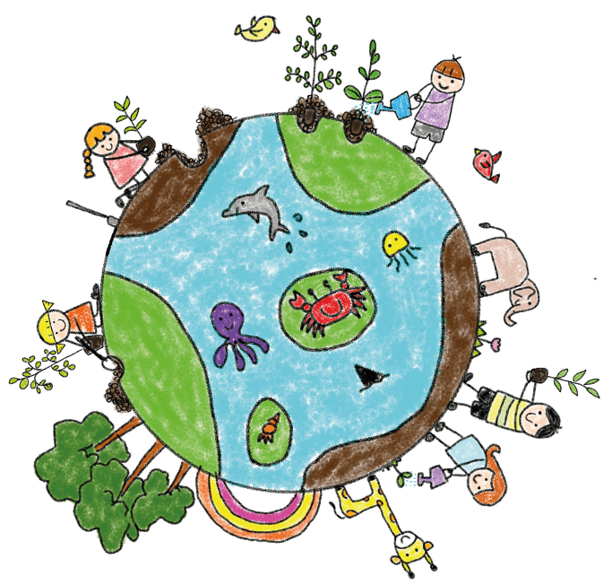

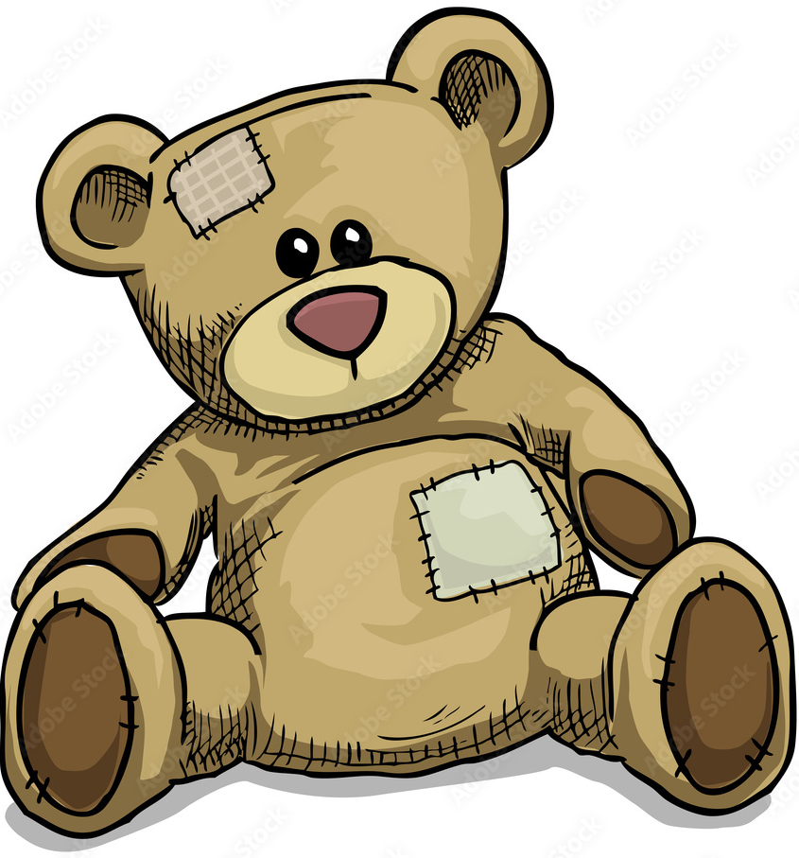

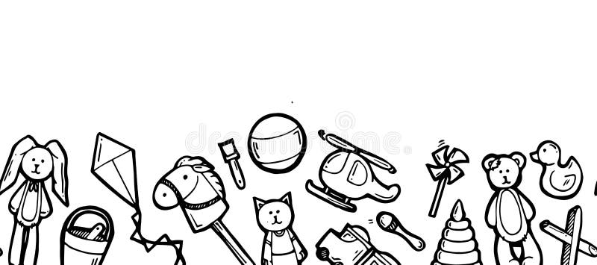
Plaza Haf – Year 1
Teganau - Toys
Toys are more than just playthings; they are a window into how the world works. This topic is vital because it bridges the gap between a child’s own personal experiences and the wider worlds of history, science, and design. Children will explore properties of materials and develop their creative and problem-solving skills as they design and build their own toy. By looking at toys from the past and present, children will develop a sense of chronology and an understanding of how technology and materials have evolved over time. Children will build curiosity, develop historical awareness, and begin to understand how everyday life reflects wider changes in society, all whilst exploring something they love.
In Literacy, we will be learning to:
Use exciting and descriptive language in poetry writing.
Develop speaking and listening skills when participating in group oracy activities.
Write to inform and explain, creating a fact sheet about a toy.
Write in full sentences, using capital letters, finger spaces and full stops.
Extend our sentences using conjunctions (and, so, or, but, because).
Describe settings and characters in new and familiar stories.
Sequence and retell traditional stories.
Within this topic, we will be learning to:
Compare toys from the past and present – toys children enjoy today with those played with by parents and grandparents.
Investigate materials of toys –what toys are made of, the properties of materials, and why those materials were chosen.
Explore forces – what makes a toy start, stop, or change direction?
Discuss the sentimental value of toys – why they are special, and how to treat toys with care.
Explore global cultures – discovering unique toys from different cultures around the world.
Challenge stereotypes with toys – who decides what toys are “for” boys and what toys are “for” girls?
Notice line and shape – developing our observational drawing skills when drawing toys.
Design toys – putting on our thinking caps to design and build original new toys.
In Numeracy, we will be learning to:
Use standard and non-standard units to measure length and weight and capacity.
Collect, represent and analyse data about toys using tally charts pictograms
Add and subtract numbers to 20
Use physical resources to count in 2s and 5s.
Welsh Language Patterns
Sut mae’r tywydd heddiw? – What is the weather like? Mae hi’n… - It is…
Oes … da ti? – Do you have…?
Beth wyt ti’n hoffi chwarae? – What do you like to play?
Other Information
PE will take place on Mondays.
Forest School will take place on Fridays.
PE
Our unit this term is ‘ball skills’.

